Slide 1
Varithms -
An E-Learning Based Platform for Algorithms
Mini Project
Vivek Sharma Akarsh Singh Gangwar Akansha Saxena Ankita Sinha
181500820 181500055 181500054 181500101
Ansh Baranwal
181500105

Slide 2

Logo
User whenever use a particular type of app or website, they often check logo for to verify if the product is genuine or not.
Our logo not only represent us but also what what the product is about and what you should expect.

Slide 3
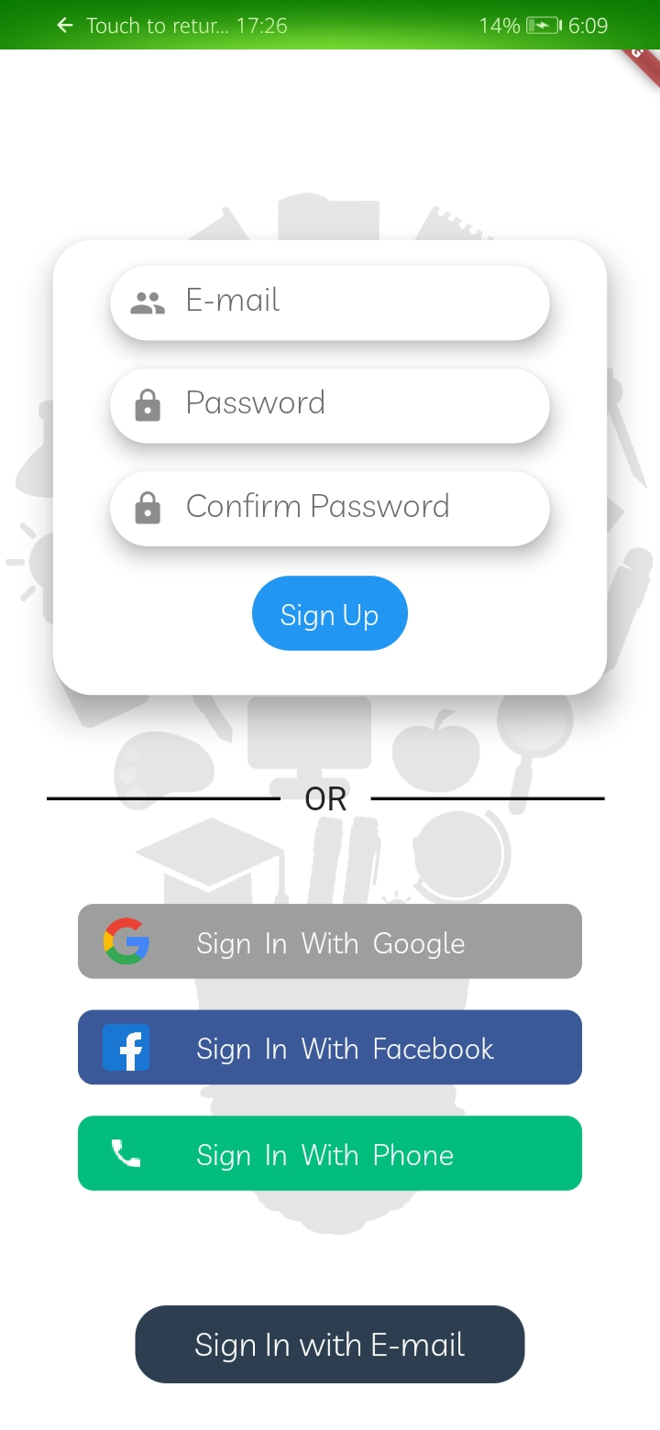
Signup Screen:
User needs to get register on our database by given means.
They can sign up through Google, facebook or valid phone number.
They must re-type the password to ensure that the password used during regiseration will be remembered by the user.

Slide 4
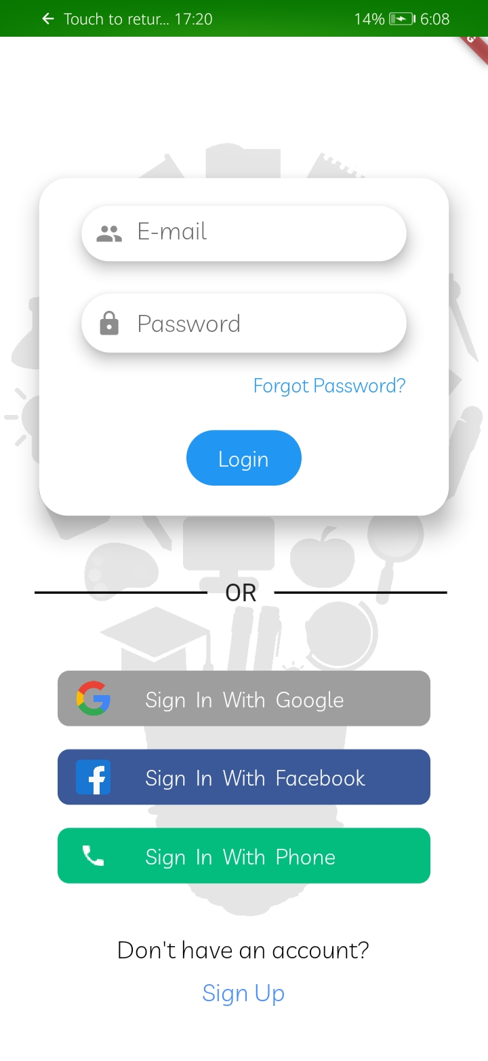
Login Screen
They ensure the security measures that your data and progess report should remain confidential.
Users can login through email and password or to ease up, they can directly use the login method they used while signing up which were google, facebook or their phone number.

Slide 5
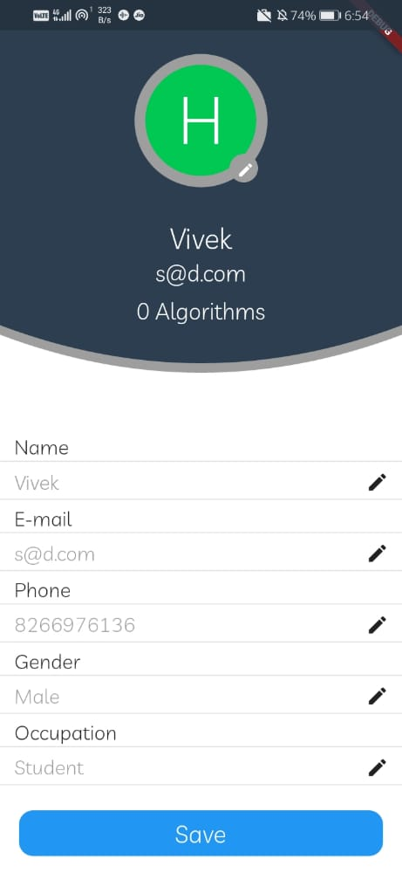
User Credential
This method is asked during signup process to make sure that an unauthorized doesn’t change or use your data.
Different credentials are asked to differentiate between two users, so that, no same person can have access using same credentials.

Slide 6
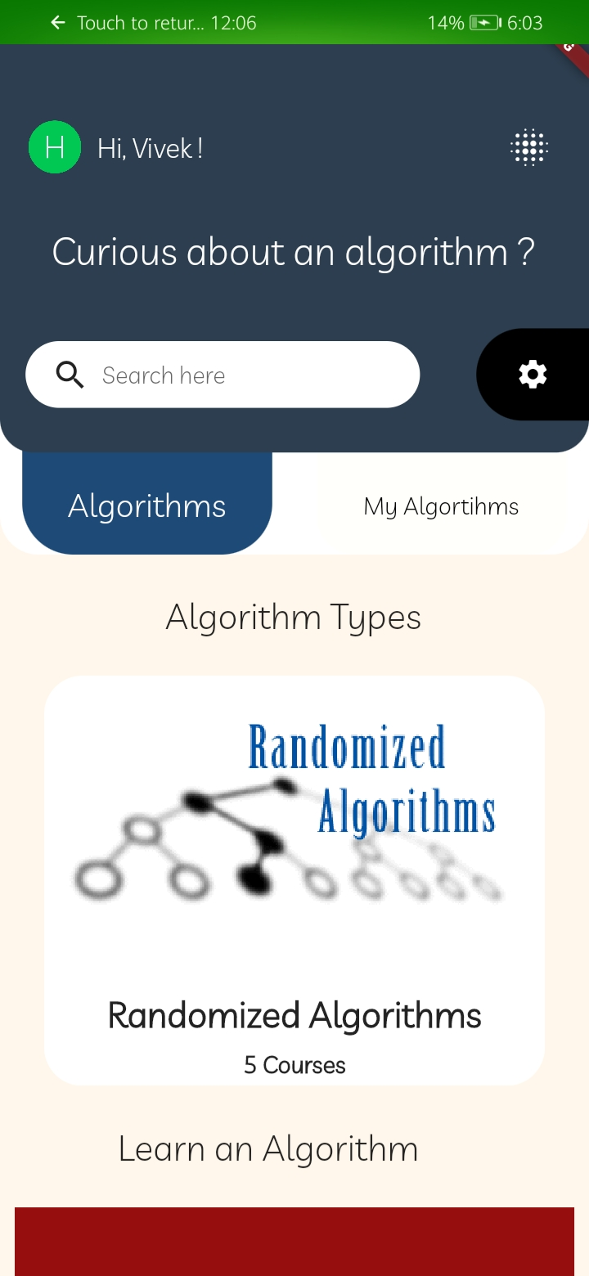
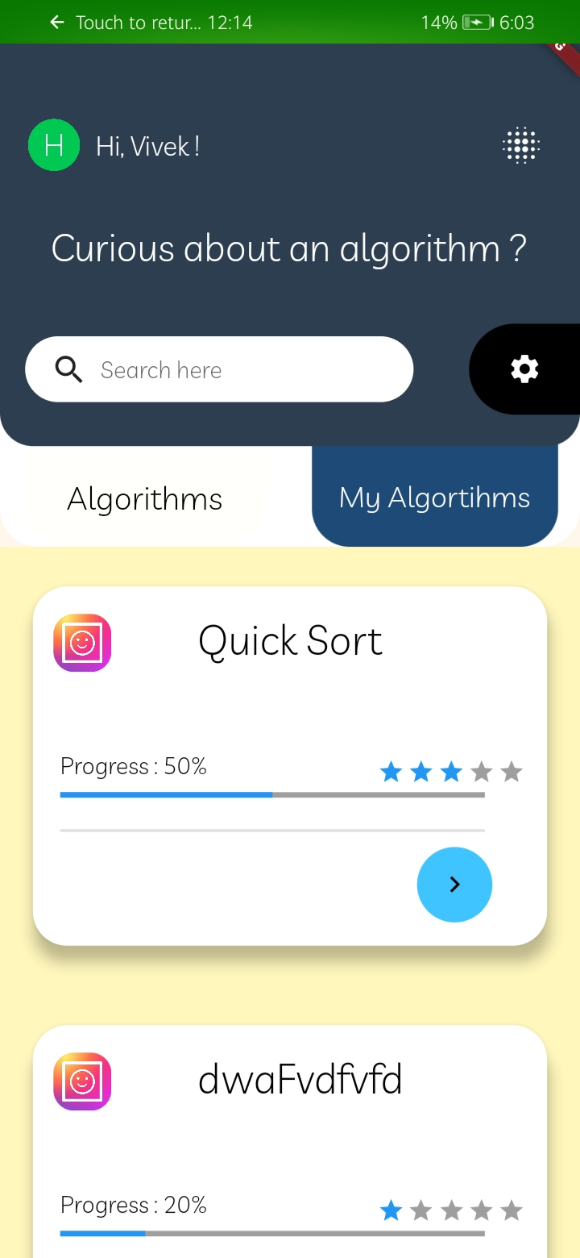
After Login
Now, user can check what algorithm, the system provides on their very first page,
User can also check their progress of algorithms they opened.

Slide 7
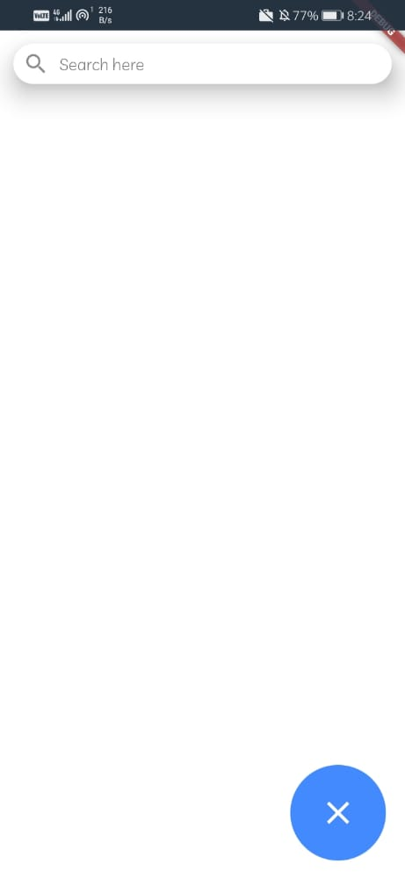
Search Box
For comfort of users, unknown to working of ‘Varithms’, a search box is given so that they can they can directly go to their desired algorithm, when they don’t know the exact address.
It thus offers, a convenient way, to search term or query when it is entered into search box and serch button is clicked.

Slide 8
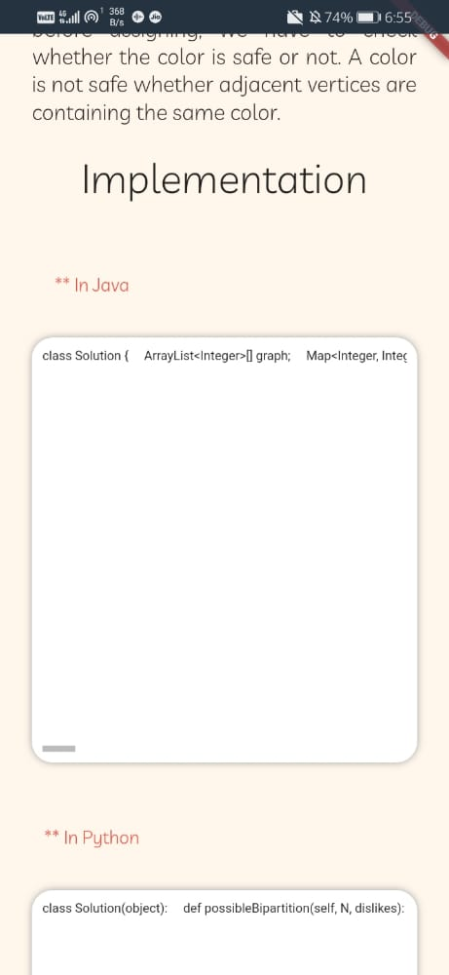
Implementation
Different users prefer different languages for coding.
Here, in ‘Varithms’, for user satisfaction, all major languages are used. Now, user can understand any algorithm in their desired language.

Slide 9
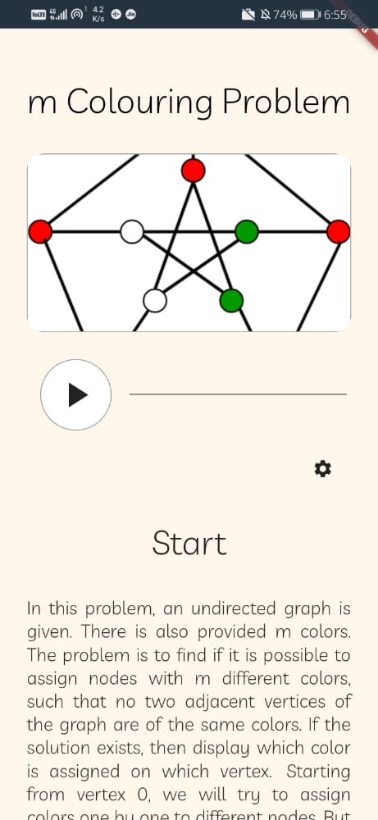
Algorithm Screen
Here, what looks like when you open any algorithm.
For comfort of users, the algorithm is explained in both text as well as ‘Text-to-speach’ method.
If users wants to change some setting, a setting button is also given on the screen for less hassle.

Slide 10
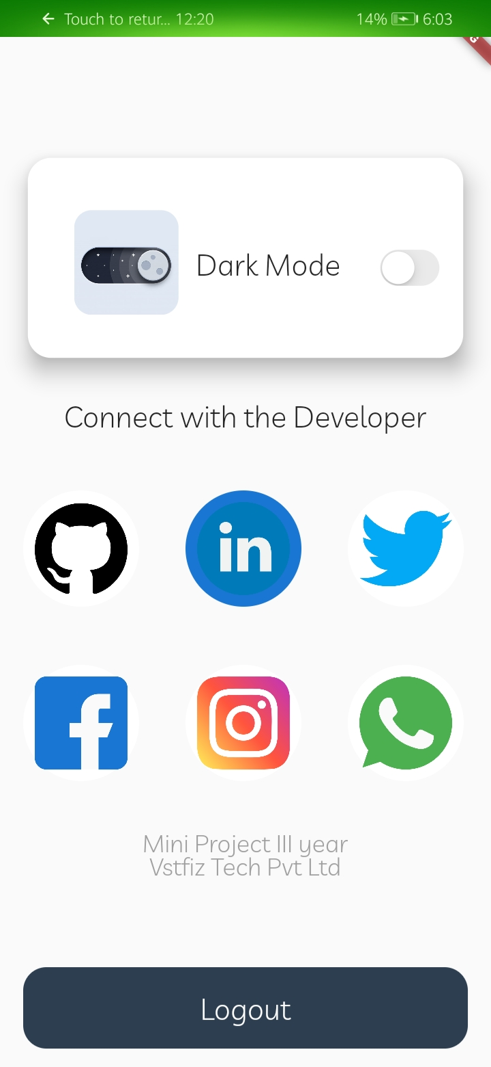
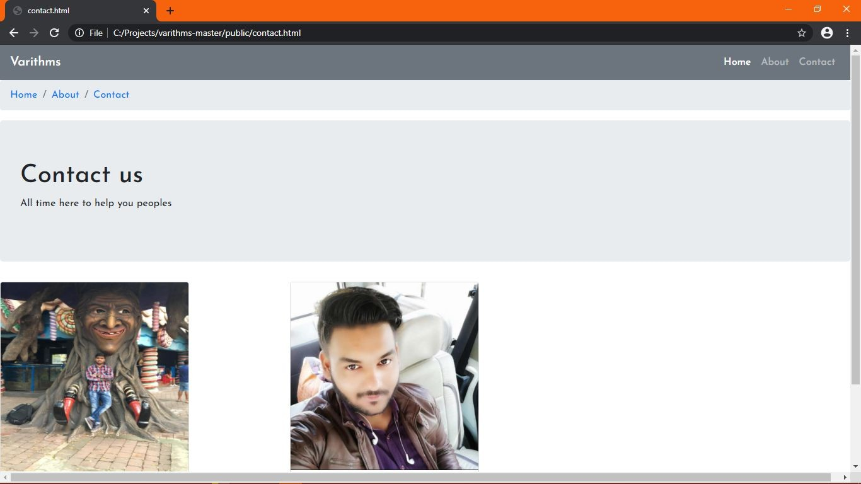
Themes and Contact
Who doesn’t wants their apps to have multiple themes to look according to their style.
Users can easily contacts the developers through the means they want and not they don’t have.

Slide 11
Thank You

